Slide 1

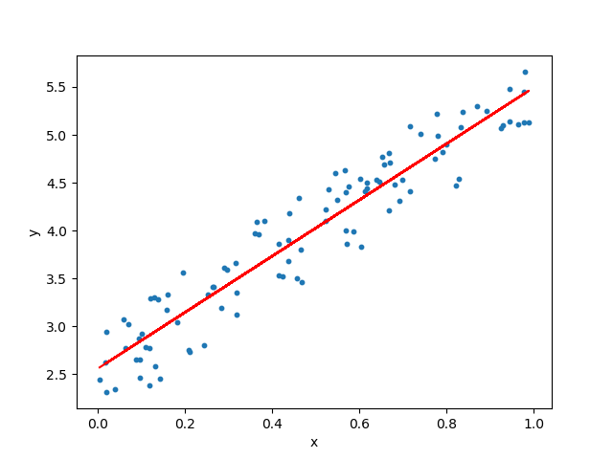
MCSE0007: Machine Learning
Decision Tree
Class Presentations on Machine Learning by Prof. Anand Singh Jalal

Slide 2
Overview Classification Definition
Given a collection of records (training set )
Each record contains a set of attributes, one of the attributes is the class.
Find a model for class attribute as a function of the values of other attributes.
Goal: previously unseen records should be assigned a class as accurately as possible.
A test set is used to determine the accuracy of the model. Usually, the given data set is divided into training and test sets, with training set used to build the model and test set used to validate it.

Slide 3
Illustrating Classification Task

Slide 4

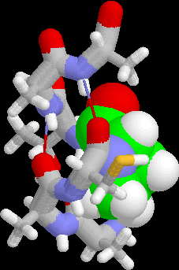
Examples of Classification Task
Predicting tumor cells as benign or malignant
Classifying credit card transactions as legitimate or fraudulent
Classifying secondary structures of protein as alpha-helix, beta-sheet, or random coil
Categorizing news stories as finance, weather, entertainment, sports, etc

Slide 5
What is a Decision Tree?
An inductive learning task
Use particular facts to make more generalized conclusions
A predictive model based on a branching series of Boolean tests
These smaller Boolean tests are less complex than a one-stage classifier
Let’s look at a sample decision tree…
Notes:
Regression is a statistical measurement that attempts to determine the strength of the relationship between one dependent variable (usually denoted by Y) and a series of other changing variables (known as independent variables).

Slide 6
Decision Tree Representation
Good day for tennis?
Leaves = classification
Arcs = choice of value
for parent attribute
Outlook
Sunny
Rain
Overcast
Humidity
Wind
Play
Strong
Weak
High
Normal
Don’t play
Play
Don’t play
Play
Decision tree is equivalent to logic in disjunctive normal form
Play ⇔ (Sunny ∧ Normal) ∨ Overcast ∨ (Rain ∧ Weak)

Slide 7
Example of a Decision Tree
categorical
categorical
continuous
class
Splitting Attributes
Refund
Yes
No
NO
MarSt
Single, Divorced
Married
TaxInc
NO
< 80K
> 80K
NO
YES
Training Data
Model: Decision Tree

Slide 8
Example of a Decision Tree …
categorical
categorical
continuous
class
MarSt
Single, Divorced
Married
NO
Refund
Yes
No
NO
TaxInc
< 80K
> 80K
NO
YES
There could be more than one tree that fits the same data!

Slide 9
Apply Model to Test Data
Test Data
Start from the root of tree.
Refund
Yes
No
NO
MarSt
Single, Divorced
Married
TaxInc
NO
< 80K
> 80K
NO
YES

Slide 10
Apply Model to Test Data …
Test Data
Refund
Yes
No
NO
MarSt
Single, Divorced
Married
TaxInc
NO
< 80K
> 80K
NO
YES

Slide 11
Apply Model to Test Data …
Test Data
Refund
Yes
No
NO
MarSt
Single, Divorced
Married
TaxInc
NO
< 80K
> 80K
NO
YES

Slide 12
Apply Model to Test Data …
Test Data
Refund
Yes
No
NO
MarSt
Single, Divorced
Married
TaxInc
NO
< 80K
> 80K
NO
YES

Slide 13
Apply Model to Test Data …
Test Data
Refund
Yes
No
NO
MarSt
Single, Divorced
Married
TaxInc
NO
< 80K
> 80K
NO
YES

Slide 14
Apply Model to Test Data …
Test Data
Refund
Yes
No
NO
MarSt
Single, Divorced
Married
Assign Cheat to “No”
TaxInc
NO
< 80K
> 80K
NO
YES

Slide 15
Top-Down Induction of Decision Trees: ID3
A ← the “best” decision attribute for next node
Assign A as decision attribute for node
For each value of A create new descendant
Sort training examples to leaf node according to
the attribute value of the branch
If all training examples are perfectly classified (same value of target attribute) stop, else iterate over new leaf nodes.

Slide 16
Which attribute is best?
[29+,35-]
A₁=?
A₂=?
[29+,35-]
G
H
L
M
[21+, 5-]
[8+, 30-]
[18+, 33-]
[11+, 2-]

Slide 17
Entropy
To determine the best attribute, we look at the ID3 heuristic
ID3 splits attributes based on their entropy.
Entropy is the measure of disinformation…
Entropy is minimized when all values of the target attribute are the same.
Entropy is maximized when there is an equal chance of all values for the target attribute (i.e. the result is random)

Slide 18
Entropy …
Let S be a set of examples
Entropy(S) = -P₊ log₂(P₊) – P₋ log₂(P₋)
P₊ is proportion of pos example
P₋ is proportion of neg examples
0 log 0 == 0
Example: S has 9 pos and 5 neg Entropy([9+, 5-]) = -(9/14) log₂(9/14) - (5/14)log₂(5/14)
= 0.940

Slide 19
Entropy …
50-50 class split
Maximum disorder
1.0
0.5
All positive
Pure distribution
% of example that are positive
.00 .50 1.00

Slide 20
Information Gain …
Measure of expected reduction in entropy
Resulting from splitting along an attribute
Σ
v ∈ Values(A)
Gain(S,A) = Entropy(S) - (|Sv| / |S|) Entropy(Sv)
Where Entropy(S) = -P log₂(P) - N log₂(N)

Slide 21
Information Gain …
Values(wind)=weak, strong
S = [9+, 5-]
Day Wind Tennis?
d1 weak n
d2 s n
d3 weak yes
d4 weak yes
d5 weak yes
d6 s n
d7 s yes
d8 weak n
d9 weak yes
d10 weak yes
d11 s yes
d12 s yes
d13 weak yes
d14 s n
S_{weak} = [6+, 2-]
S_{s} = [3+, 3-]
Gain(S, wind)
= Entropy(S) - (|S_{v}| / |S|) Entropy(S_{v})
= Entropy(S) - 8/14 Entropy(S_{weak})
- 6/14 Entropy(S_{s})
= 0.940 - (8/14) 0.811 - (6/14) 1.00
= .048
Σ
v ∈ {weak, s}

Slide 22
Training Examples
Day
Outlook
Temp.
Humidity
Wind
Play Tennis
D1
Sunny
Hot
High
Weak
No
D2
Sunny
Hot
High
Strong
No
D3
Overcast
Hot
High
Weak
Yes
D4
Rain
Mild
High
Weak
Yes
D5
Rain
Cool
Normal
Weak
Yes
D6
Rain
Cool
Normal
Strong
No
D7
Overcast
Cool
Normal
Weak
Yes
D8
Sunny
Mild
High
Weak
No
D9
Sunny
Cold
Normal
Weak
Yes
D10
Rain
Mild
Normal
Strong
Yes
D11
Sunny
Mild
Normal
Strong
Yes
D12
Overcast
Mild
High
Strong
Yes
D13
Overcast
Hot
Normal
Weak
Yes
D14
Rain
Mild
High
Strong
No

Slide 23
Selecting the Next Attribute
S=[9+,5-]
E=0.940
S=[9+,5-]
E=0.940
Humidity
Wind
High
Normal
Weak
Strong
[3+, 4-]
[6+, 1-]
[6+, 2-]
[3+, 3-]
E=0.592
E=0.811
E=0.985
E=1.0
Gain(S,Humidity)
=0.940-(7/14)*0.985
– (7/14)*0.592
=0.151
Gain(S,Wind)
=0.940-(8/14)*0.811
– (6/14)*1.0
=0.048
Humidity provides greater info. gain than Wind, w.r.t target classification.

Slide 24
Selecting the Next Attribute …
S=[9+,5-]
E=0.940
Outlook
Over
cast
Sunny
Rain
[2+, 3-]
[4+, 0]
[3+, 2-]
E=0.971
E=0.0
E=0.971
Gain(S,Outlook)
=0.940-(5/14)*0.971
-(4/14)*0.0 – (5/14)*0.0971
=0.247

Slide 25
Selecting the Next Attribute …
The information gain values for the 4 attributes are:
Gain(S,Outlook) =0.247
Gain(S,Humidity) =0.151
Gain(S,Wind) =0.048
Gain(S,Temperature) =0.029
where S denotes the collection of training examples

Slide 26
ID3 Algorithm
[D1,D2,…,D14]
[9+,5-]
Outlook
Sunny
Overcast
Rain
S_{sunny} =[D1,D2,D8,D9,D11]
[2+,3-]
[D3,D7,D12,D13]
[4+,0-]
[D4,D5,D6,D10,D14]
[3+,2-]
?
Yes
?
Gain(S_{sunny}, Humidity)=0.970-(3/5)0.0 – 2/5(0.0) = 0.970
Gain(S_{sunny}, Temp.)=0.970-(2/5)0.0 –2/5(1.0)-(1/5)0.0 = 0.570
Gain(S_{sunny}, Wind)=0.970= -(2/5)1.0 – 3/5(0.918) = 0.019

Slide 27
ID3 Algorithm …
Outlook
Sunny
Overcast
Rain
Humidity
Yes
Wind
[D3,D7,D12,D13]
High
Normal
Strong
Weak
No
Yes
No
Yes
[D1,D2]
[D8,D9,D11] [mistake]
[D6,D14]
[D4,D5,D10]

Slide 28
Occam’s Razor
”If two theories explain the facts equally weel, then the simpler theory is to be preferred”
Arguments in favor:
Fewer short hypotheses than long hypotheses
A short hypothesis that fits the data is unlikely to be a coincidence
A long hypothesis that fits the data might be a coincidence
Arguments opposed:
There are many ways to define small sets of hypotheses

Slide 29
Converting a Tree to Rules
Outlook
Sunny
Overcast
Rain
Humidity
Yes
Wind
High
Normal
Strong
Weak
No
Yes
No
Yes
R₁: If (Outlook=Sunny) ∧ (Humidity=High) Then PlayTennis=No
R₂: If (Outlook=Sunny) ∧ (Humidity=Normal) Then PlayTennis=Yes
R₃: If (Outlook=Overcast) Then PlayTennis=Yes
R₄: If (Outlook=Rain) ∧ (Wind=Strong) Then PlayTennis=No
R₅: If (Outlook=Rain) ∧ (Wind=Weak) Then PlayTennis=Yes
29

Slide 30
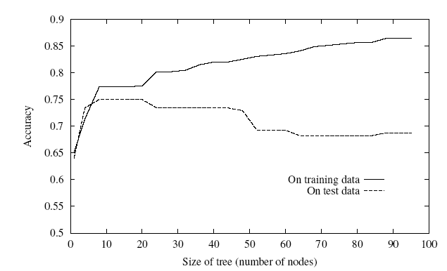
Overfitting
One of the biggest problems with decision trees is Overfitting

Slide 31
Overfitting …
DT is overfit when exists another DT’ and
DT has smaller error on training examples, but
DT has bigger error on test examples
Causes of overfitting
Noisy data, or
Training set is too small
Solutions
Reduced error pruning
Early stopping
Rule post pruning

Slide 32

Any Questions ?

